Slide 1

Large Language Models for Molecular Design
Sri Vishnu Vardhan Reddy Akepati
M.S. Data Science
Natalie Kadlubowski
M.S. Chemical and Biomolecular Engineering
Anjali Chaliha
M.S. Computer Science
Industry Mentors: Dr. Nick Iovanac, Dr. Tai-Ying Chen
Course Instructor: Prof. Arthi Jayaraman

Slide 2
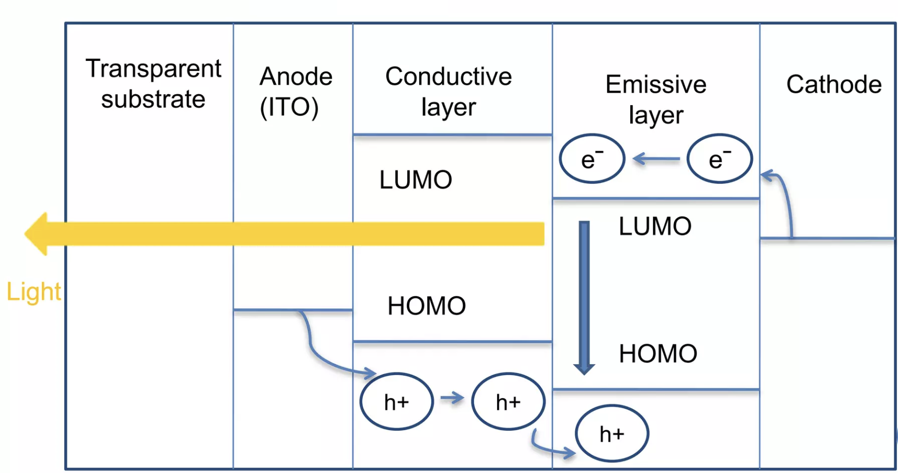
Using Large Language Models to Inform Molecular Design
Challenge: Synthesis is costly in time and money
Area of Focus: Identification of promising candidate molecules
Benefit: Novel, low cost approach to molecular design
Impact: Advancements in organic electronics, specifically OLEDs
OLED devices¹: Electrons in the LUMO combine with holes in the HOMO, emitting light
(1) OLED Technology Seminar. SlideShare. https://www.slideshare.net/ashliz/oled-technology-seminar-ppt (accessed 2024-03-31).
2
Notes:
- Challenge: Traditional methods rely heavily on trial and error due to the vast number of possible chemical structures, leading to time and cost inefficiencies.
- Approach: Utilize LLMs to predict molecular properties and generate new molecules based on user input, streamlining the identification of promising candidate molecules.
- Benefits: LLMs offer a novel approach to molecular design, potentially reducing costs and accelerating the development of high-performance materials.
- Impact: The project could lead to significant advancements in organic electronics, including OLEDs, OPVs, and OTFTs, contributing to innovation in the field of soft materials.

Slide 3
Task 1
Task 1: Develop a large language model to predict molecular properties from a chemical structure, given a dataset of structures and properties.
Structures: Canonical SMILES² strings
Properties: HOMO and LUMO energy levels
Table Input
(SMILES)
Tokenization
Encoding
Evaluated
Benchmark
Large Language Model
Random Forest
Decision Tree
Predicted Output
(HOMO, LUMO)
(2) Weininger, D. SMILES, a Chemical Language and Information System. 1. Introduction to Methodology and Encoding Rules. J. Chem. Inf. Comput. Sci. 1988, 28 (1), 31–36.
3
Notes:
Modify this to 2 goals

Slide 4
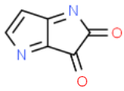
Task 2
Assign Similarity Score
Task 2: Develop a chat-based model to provide a molecular structure, given a target set of properties.
Structures: New or modified SMILES strings
Properties: Target HOMO and LUMO energy levels
Generate Training Prompts
Fine Tune
Closest Fit
c1cnc-2c(=O)c(=O)nc12
http://www.chemspider.com/Chemical-Structure.14112326.html
4
Notes:
Modify this to 2 goals

Slide 5
Project Goal: Build LLM Models to Predict Properties and Generate Molecules
Task 1
Task 2
Assign Molecular Similarity Score
Table Input
(SMILES)
Generate Training Prompts
Tokenization
Encoding
Fine Tune
Evaluated
Benchmark
Large Language Model
Random Forest
Decision Tree
Closest Fit
c1cnc-2c(=O)c(=O)nc12
(HOMO, LUMO)
Predicted Output
(HOMO, LUMO)
5
Notes:
Modify this to 2 goals

Slide 6
Project Goal: Build LLM Models to Predict Properties and Generate Molecules
Task 1
Task 2
Assign Molecular Similarity Score
Table Input
(SMILES)
Generate Training Prompts
Tokenization
Encoding
Fine Tune
Evaluated
Benchmark
Large Language Model
Random Forest
Decision Tree
Closest Fit
c1cnc-2c(=O)c(=O)nc12
(HOMO, LUMO)
Predicted Output
(HOMO, LUMO)
6
Notes:
Modify this to 2 goals

Slide 7
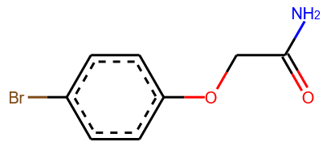
Tokenization and Encoding: Breaking Strings into “Words”
SMILES Pair Encoding³:
Data driven
Groups based on frequency in dataset
Matches or outperforms other tokenization methods
Easily implemented with Python
Input: SMILES string
NC(=O)COc1ccc(Br)cc1
Character level
Atomic level
SMILES Pair Encoding
N|C|(|=|O|)|C|O|c|1|c|c|c|(|B|r|)|c|c|1
N|C|(=O)|C|O|c|1|c|c|c|(Br)|c|c|1
N|C(=O)|C|O|c1ccccc1|(Br)
Increasing chemical relevance
https://www.pirika.com/Program/2019/RDKit-SmilesViewer.html
(3) Li, X.; Fourches, D. SMILES Pair Encoding: A Data-Driven Substructure Tokenization Algorithm for Deep Learning. Journal of Chemical Information and Modeling 2021, 61 (4), 1560–1569.
7
Notes:
Breaking of retrosynthetically interesting chemical substructures - rules around molecular cleavage

Slide 8
Project Goal: Build LLM Models to Predict Properties and Generate Molecules
Task 1
Task 2
Assign Molecular Similarity Score
Table Input
(SMILES)
Generate Training Prompts
Tokenization
Encoding
Fine Tune
Evaluated
Benchmark
Large Language Model
Random Forest
Decision Tree
Closest Fit
c1cnc-2c(=O)c(=O)nc12
(HOMO, LUMO)
Predicted Output
(HOMO, LUMO)
8
Notes:
Modify this to 2 goals

Slide 9
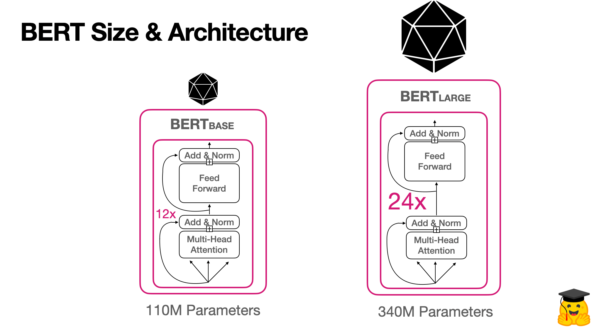
BERT: Bidirectional Encoder Representations from Transformers
BERT Tasks:
Masked language model (MLM)
Next sentence prediction (NSP)
Transformers
Attention mechanism for contextual learning
Helps BERT with parallel training on large datasets
Used for
Sentiment Analysis, Question Answering
Text prediction, Text generation
BERT based models: RoBERTa, BioBERT, VideoBERT, ALBERT etc.
(17) BERT 101 - State Of The Art NLP Model Explained (huggingface.co)
9
Notes:
Pay attention only to the things that matter without wasting computational resources.

Slide 10
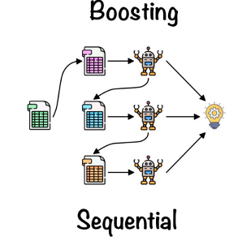
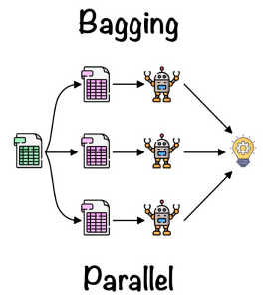
Choosing Model Architecture
RoBERTa/ChemBERTa^{4,5} (LLM)
XGBoost⁷ (Comparison)
Random Forest (Comparison)
Robustly optimized BERT training approach
Builds on BERT⁶:
Focuses on inference (prediction from context)
Faster, and larger training set size
Dynamic masking training
Byte-pair encoding
Tree-based algorithm
Aggregates output
Sequential learners
Good for smaller datasets
Tree-based algorithm
Aggregates output
Independent learners
Good for smaller datasets
15
(4) Liu, Y. et al. RoBERTa: A Robustly Optimized BERT Pretraining Approach. arXiv July 26, 2019.
(5) Chithrananda, S. et al. ChemBERTa: Large-Scale Self-Supervised Pretraining for Molecular Property Prediction. arXiv October 23, 2020.
(6) Devlin, J. et al. BERT: Pre-training of Deep Bidirectional Transformers for Language Understanding. arXiv.org.
(7) Chen, T. et al. XGBoost: A Scalable Tree Boosting System. Association for Computing Machinery: New York, NY, USA, 2016; pp 785–794.
(15) Random Forest Algorithm for Absolute Beginners in Data Science (analyticsvidhya.com)
10
Notes:
Aggregate Output: Major Voting or Averaging
Contextual Learning: finding important tokens based on surrounding tokens

Slide 11
Task 1: Predictive Model Development Workflow
Dataset: 94,368 organic small molecules^{8,9}, associated HOMO and LUMO energy levels
Evaluation: Comparison of predicted and actual energy levels
Tokenize Data
Train and Predict
Character Level
ChemBERTa (LLM)
Evaluate
Property prediction
output:
[HOMO, LUMO]
SMILES Dataset
Validate SMILES
Atomic Level
XGBoost
SMILES Pair Encoding
Random Forest
9 sets of model results,
2 target properties
Tokenization Methods
Models
(8) Pereira, F. et al. Machine Learning Methods to Predict Density Functional Theory B3LYP Energies of HOMO and LUMO Orbitals. 2017, 57 (1), 11–21.
(9) Chemical Materials Repository. Database of Organic Donor Acceptor Molecules. https://cmr.fysik.dtu.dk/solar/solar.html (accessed 2024-03-31).
11

Slide 12
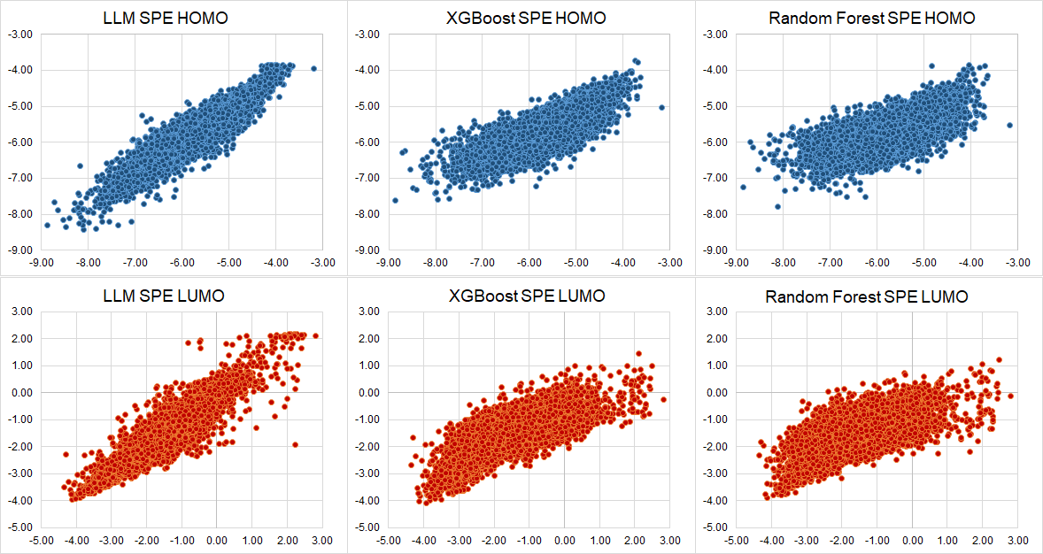
Task 1: LLM Outperforms Other Machine Learning Models on Prediction
LLM (RoBERTa)
XGBoost Decision Tree
Random Forest
Test Sets:
18,867 Molecules
Ideal:
MSE: Mean Square Error
HOMO
MSE: 0.04 MSE: 0.17 MSE: 0.13
Predicted Orbital Energy Level (eV)
LUMO
MSE: 0.08 MSE: 0.34 MSE: 0.25
Actual Orbital Energy Level (eV)
12

Slide 13
Results: Molecular Property Prediction
Tokenization | Properties | RoBERTa/ ChemBERTa (MSE/R²) | XGBoost (MSE/R²) | Random Forest (MSE/R²)
Character Level | HOMO | 0.05/0.86 | 0.11/0.70 | 0.14/0.60
 | LUMO | 0.08/0.90 | 0.19/0.77 | 0.25/0.69
Atomic Level | HOMO | 0.05/0.87 | 0.10/0.72 | 0.14/0.62
 | LUMO | 0.08/0.91 | 0.18/0.79 | 0.26/0.68
Data Driven (SMILES Pair Encoding) | HOMO | 0.04/0.87 | 0.13/0.64 | 0.17/0.53
 | LUMO | 0.08/0.90 | 0.25/0.70 | 0.34/0.58
Takeaway: Our large language model outperforms other machine learning models for HOMO/LUMO energy level prediction.
MSE - Mean Squared Error
R² - Coefficient of Determination (for y = x)
13

Slide 14
Project Goal: Build LLM Models to Predict Properties and Generate Molecules
Task 1
Task 2
Assign Molecular Similarity Score
Table Input
(SMILES)
Generate Training Prompts
Tokenization
Encoding
Fine Tune
Evaluated
Benchmark
Large Language Model
Random Forest
Decision Tree
Closest Fit
c1cnc-2c(=O)c(=O)nc12
(HOMO, LUMO)
Predicted Output
(HOMO, LUMO)
14
Notes:
Modify this to 2 goals

Slide 15
Task 2: Method Workflow
Dataset: SMILES dataset curated for task 1
Approach: Created SMILES - similar SMILES dataset, generated ~350,000 prompts from it
Evaluation: Comparison with before and after fine tuned chat model
Training and Fine Tuning
Performance Comparison
Molecules from SMILES Dataset
Calculate and map similar molecules
Generate prompts
Train prompts on Llama-2-7B-chat¹⁰ Model
Evaluate models
before and after fine-tuning
Fine tuning with QLoRA
(10) Touvron, H. et al. Llama 2: Open Foundation and Fine-Tuned Chat Models. arXiv.org.
15

Slide 16
Project Goal: Build LLM Models to Predict Properties and Generate Molecules
Task 1
Task 2
Assign Molecular Similarity Score
Table Input
(SMILES)
Generate Training Prompts
Tokenization
Encoding
Fine Tune
Evaluated
Benchmark
Large Language Model
Random Forest
Decision Tree
Closest Fit
c1cnc-2c(=O)c(=O)nc12
(HOMO, LUMO)
Predicted Output
(HOMO, LUMO)
16
Notes:
Modify this to 2 goals

Slide 17
Task 2 : Assign Molecular Similarity Score
Goal: Identify most similar molecule from dataset
Generate Morgan Fingerprints¹¹
Calculate similarity of molecules
Maps each SMILES to highest Tanimoto Similarity SMILES
SMILES Dataset
Using RDKit
Using Tanimoto Similarity (Jaccard Index)
Conclusion: We now have linked SMILES and their similar SMILES with properties, without explicitly calculating properties.
(11) Morgan, H. L. The Generation of a Unique Machine Description for Chemical Structures-A Technique Developed at Chemical Abstracts Service. Journal of Chemical Documentation 1965, 5 (2), 107–113.
17
Notes:
Steps
Convert SMILES to molecules using RDKit
Generate Morgan Fingerprints for each molecule (radius =2)
Use Tanimoto similarity to calculate similarity between molecules.
Map each SMILES with SMILES that has highest Tanimoto Similarity.

Slide 18
Project Goal: Build LLM Models to Predict Properties and Generate Molecules
Task 1
Task 2
Assign Molecular Similarity Score
Table Input
(SMILES)
Generate Training Prompts
Tokenization
Encoding
Fine Tune
Evaluated
Benchmark
Large Language Model
Random Forest
Decision Tree
Closest Fit
c1cnc-2c(=O)c(=O)nc12
(HOMO, LUMO)
Predicted Output
(HOMO, LUMO)
18
Notes:
Modify this to 2 goals

Slide 19



Task 2: Input - Automation of Prompt dataset creation using SMILES data
Question: I have a compound represented by this SMILES code {CAN_SMILES} and its HOMO value is currently at {HOMO}. Increase its HOMO value and give me a similar SMILES.
Answer: Explore the compound with SMILES {MOST_SIMILAR_SMILES} which exhibits an augmented HOMO value of {SIMILAR_HOMO} where we increased the HOMO value by {SIMILAR_HOMO} - {HOMO}
Similarly, we created ~350,000 prompts from SMILES - Similar SMILES dataset.
Image credit:-
Man & woman- https://pngtree.com
Robot: https://www.imagella.com/products/4k-robot-clipart-in-minimalist-art-style-vector-svg
19

Slide 20
Project Goal: Build LLM Models to Predict Properties and Generate Molecules
Task 1
Task 2
Assign Molecular Similarity Score
Table Input
(SMILES)
Generate Training Prompts
Tokenization
Encoding
Fine Tune
Evaluated
Benchmark
Large Language Model
Random Forest
Decision Tree
Closest Fit
c1cnc-2c(=O)c(=O)nc12
(HOMO, LUMO)
Predicted Output
(HOMO, LUMO)
20
Notes:
Modify this to 2 goals

Slide 21
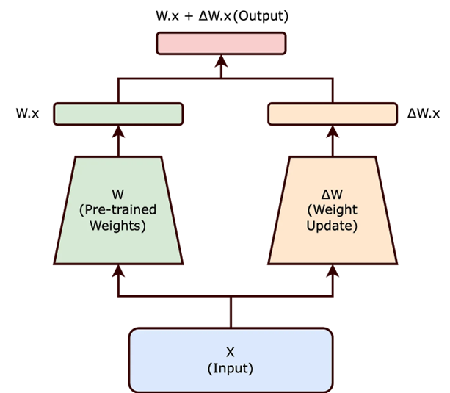
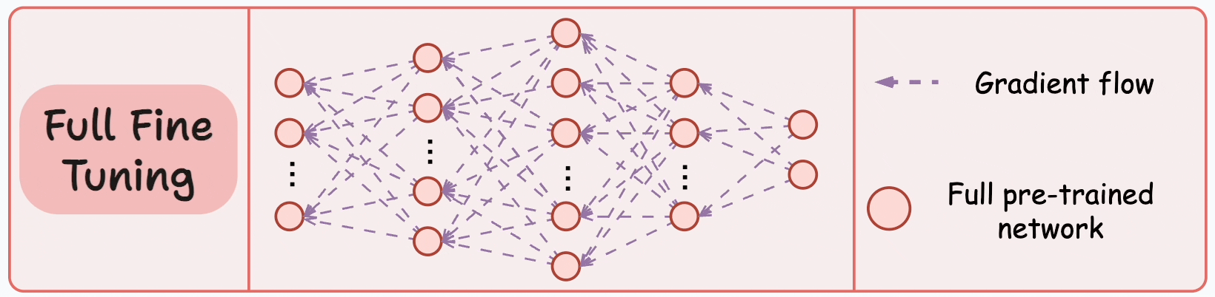
Task 2: Full Fine-Tuning and its Challenges
Fine Tuning: Process of training a pre-trained model on a new dataset to update its weights for a specific task.
Used to tune LLM to perform specific task on a custom dataset.
Challenges:
Model training can be very time-consuming and computationally intensive, often requiring high-performance GPUs.
Training a large 7 billion parameter language model would need around 168GB of GPU RAM, but the most powerful NVIDIA A100 GPUs only have 80GB of RAM.
Updating Weights¹⁶
21
(16) blog.dailydoseofds.com

Slide 22
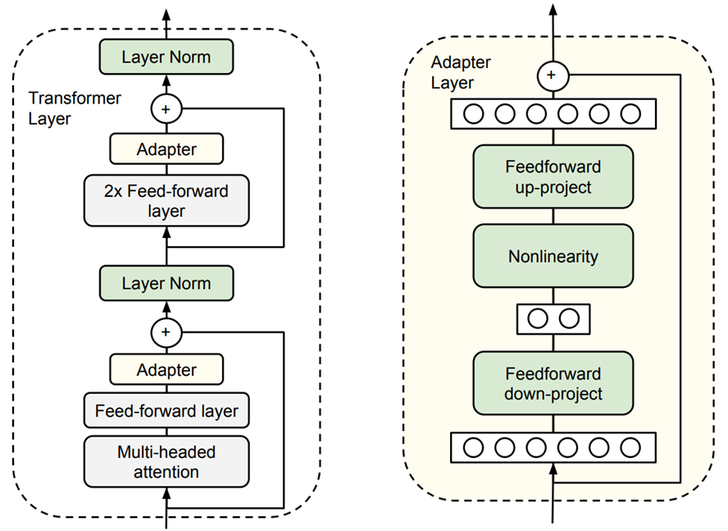
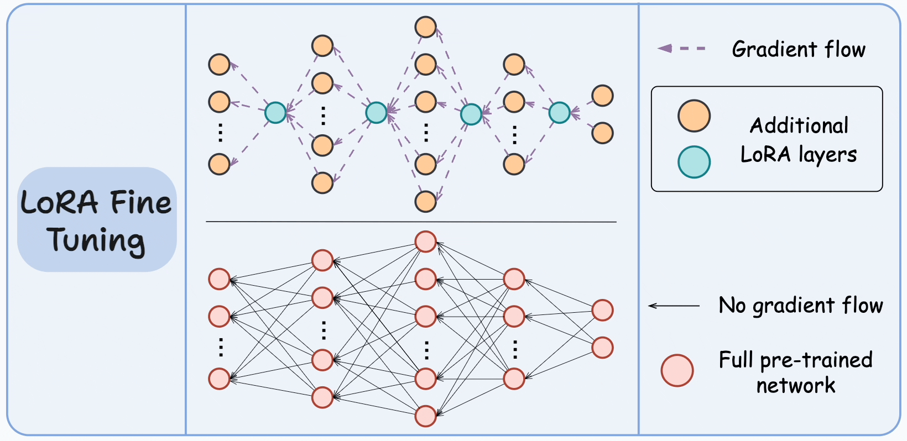
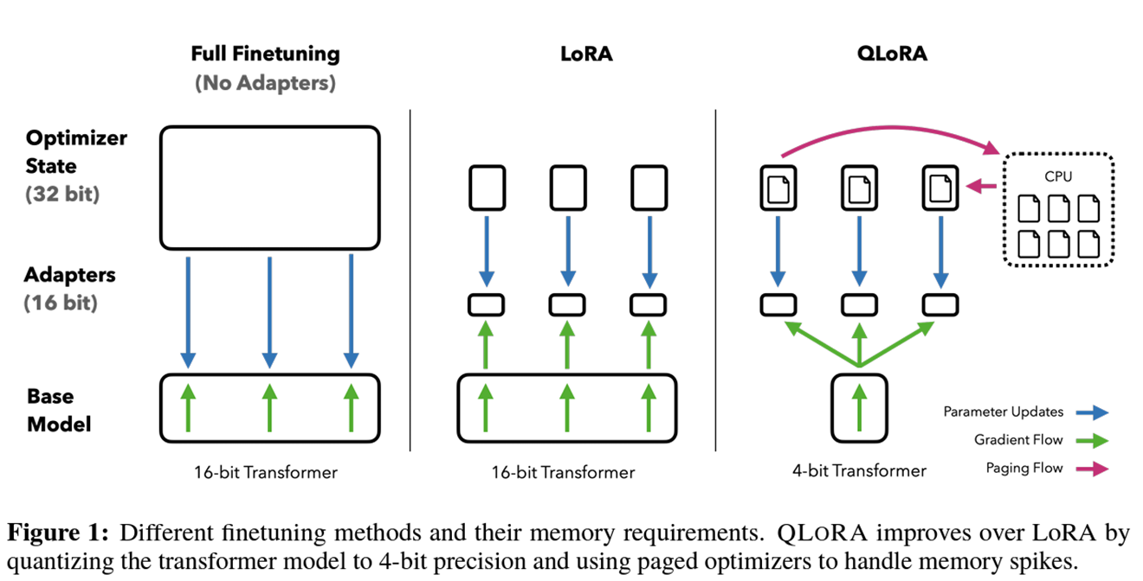
Task 2: Techniques to Fine Tune LLM
How LLMs are fine tuned?
Adapter 1: LoRA
Adapter 2: QLoRA
PEFT¹² (Parameter Efficient Fine Tuning)
- Techniques for fine tuning large models.
- Freeze whole or parts of the model without affecting performance.
Adapters
A PEFT technique
Add extra layers to the pre-trained model architecture for fine tuning.
LoRA¹³ (Low Rank Adaptation)
Reduces the number of trainable parameters.
Represents weights using fewer dimensions.
Outperforms full fine-tuning by tuning 2% of model’s parameters
QLoRA¹⁴ (Quantized LoRA)
Extended over LoRA technique.
Quantizes weight parameters of pre-trained LLM to 4-bit precision.
Reduces memory requirements of LLM.
(12) Han, Z. et al. Parameter-Efficient Fine-Tuning for Large Models: A Comprehensive Survey.
(13) Hu, E. et al. LORA: LOW-RANK ADAPTATION of LARGE LANGUAGE MODELS.
(14) Dettmers, T. et al. QLORA: Efficient Finetuning of Quantized LLMs.
[16] blogs.dailydoseofds.com
22

Slide 23
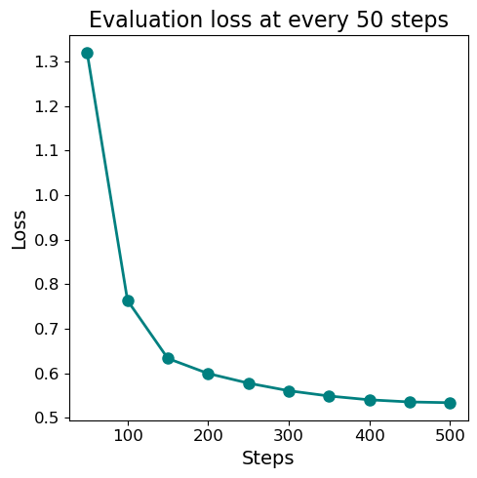
Fine-tuning results of Llama-2-7B-chat model
We fine tuned the Llama-2-7B-chat model using the QLoRA technique with 4-bit quantization.
We trained for 500 steps, evaluating model performance at every 50 steps.
Using 2 V100 GPUs with 32GB RAM each, the fine tuning process took approximately 1 day and 6 hours.
We used Weights and Biases tool to monitor our training process and GPU usage.
23

Slide 24
Project Goal: Build LLM Models to Predict Properties and Generate Molecules
Task 1
Task 2
Assign Molecular Similarity Score
Table Input
(SMILES)
Generate Training Prompts
Tokenization
Encoding
Fine Tune
Evaluated
Benchmark
Large Language Model
Random Forest
Decision Tree
Closest Fit
c1cnc-2c(=O)c(=O)nc12
(HOMO, LUMO)
Predicted Output
(HOMO, LUMO)
24
Notes:
Modify this to 2 goals

Slide 25
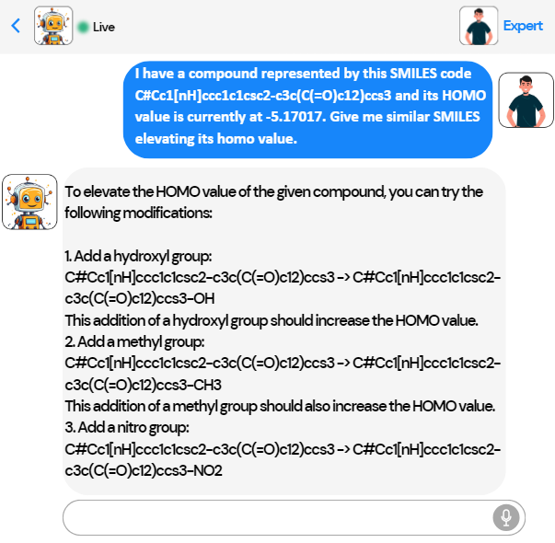
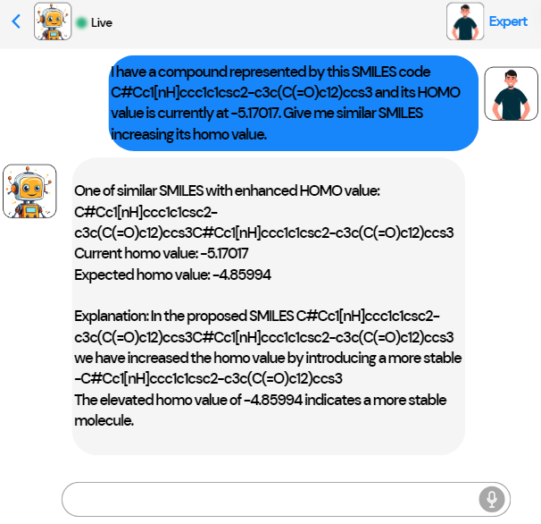
Demo of Llama-2-7B-Chat Model Performance
Before Fine Tuning
After Fine Tuning
Gives suggestions based on general knowledge
Gives suggestions tuning to our dataset
Takeaway: Fine-tuning large language models for specific tasks can be achieved without the need to adjust every parameter in the model.
25

Slide 26
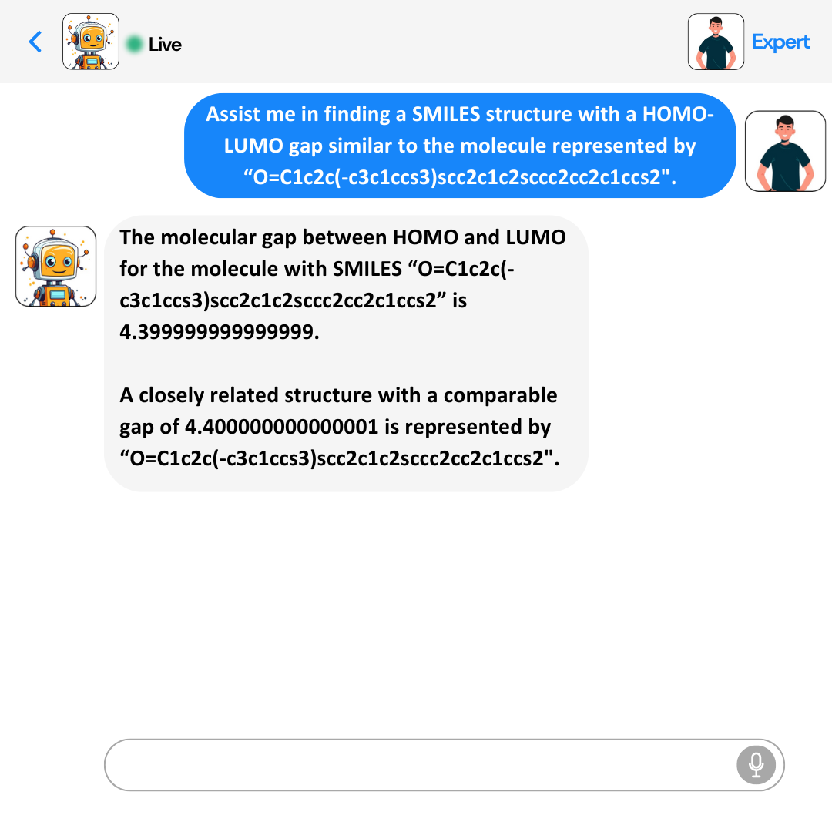
Conclusions
Our RoBERTa model accurately predicts both HOMO and LUMO properties from SMILES with over a wide range of energy levels.
Created similar SMILES dataset, Prompt dataset
Our fine-tuned Llama-2 model chats with you providing candidate molecules (similar SMILES) based on expected HOMO/LUMO levels or gap between them.
Predicted Orbital Energy Level (eV)
MSE: 0.04 MSE: 0.08
Actual Orbital Energy Level (eV)
26

Slide 27
Future Work: Possibilities to explore
Task 1:
Customizing tokenization levels within different architectures, such as RoBERTa, can enhance model accuracy.
Task 2:
More evaluation metrics to compare fine-tuned LLMs
Developing datasets with extended conversations specifically tailored for prompts can increase the accuracy of Llama models.
Deploying LLMs, providing UI to chat with these models.
Implementing RAG technique can improve accuracy.
27

Slide 28
References
OLED Technology Seminar. SlideShare. https://www.slideshare.net/ashliz/oled-technology-seminar-ppt (accessed 2024-03-31).
Weininger, D. SMILES, a Chemical Language and Information System. 1. Introduction to Methodology and Encoding Rules. J. Chem. Inf. Comput. Sci. 1988, 28 (1), 31–36. https://doi.org/10.1021/ci00057a005.
Li, X.; Fourches, D. SMILES Pair Encoding: A Data-Driven Substructure Tokenization Algorithm for Deep Learning. Journal of Chemical Information and Modeling 2021, 61 (4), 1560–1569. https://doi.org/10.1021/acs.jcim.0c01127.
Liu, Y.; Ott, M.; Goyal, N.; Du, J.; Joshi, M.; Chen, D.; Levy, O.; Lewis, M.; Zettlemoyer, L.; Stoyanov, V. RoBERTa: A Robustly Optimized BERT Pretraining Approach. arXiv July 26, 2019. https://doi.org/10.48550/arXiv.1907.11692.
Chithrananda, S.; Grand, G.; Ramsundar, B. ChemBERTa: Large-Scale Self-Supervised Pretraining for Molecular Property Prediction. arXiv October 23, 2020. http://arxiv.org/abs/2010.09885 (accessed 2024-04-23).
Devlin, J.; Chang, M.-W.; Lee, K.; Toutanova, K. BERT: Pre-training of Deep Bidirectional Transformers for Language Understanding. arXiv.org. https://arxiv.org/abs/1810.04805.
Chen, T.; Guestrin, C. XGBoost: A Scalable Tree Boosting System. In Proceedings of the 22nd ACM SIGKDD International Conference on Knowledge Discovery and Data Mining; KDD ’16; Association for Computing Machinery: New York, NY, USA, 2016; pp 785–794. https://doi.org/10.1145/2939672.2939785.
Pereira, F.; Xiao, K.; Diogo; Wu, C.; Zhang, Q.; João Aires-de-Sousa. Machine Learning Methods to Predict
Chemical Materials Repository. Database of Organic Donor Acceptor Molecules. https://cmr.fysik.dtu.dk/solar/solar.html (accessed 2024-03-31).
Touvron, H.; Martin, L.; Stone, K.; Albert, P.; Almahairi, A.; Babaei, Y.; Bashlykov, N.; Batra, S.; Bhargava, P.; Bhosale, S.; Bikel, D.; Blecher, L.; Ferrer, C. C.; Chen, M.; Cucurull, G.; Esiobu, D.; Fernandes, J.; Fu, J.; Fu, W.; Fuller, B. Llama 2: Open Foundation and Fine-Tuned Chat Models. arXiv.org. https://doi.org/10.48550/arXiv.2307.09288.
Morgan, H. L. The Generation of a Unique Machine Description for Chemical Structures-A Technique Developed at Chemical Abstracts Service. Journal of Chemical Documentation 1965, 5 (2), 107–113. https://doi.org/10.1021/c160017a018.
Han, Z.; Gao, C.; Liu, J.; Zhang, J.; Zhang, S. Parameter-Efficient Fine-Tuning for Large Models: A Comprehensive Survey. https://arxiv.org/pdf/2403.14608 (accessed 2024-05-05).
Hu, E.; Shen, Y.; Wallis, P.; Allen-Zhu, Z.; Li, Y.; Wang, S.; Wang, L.; Chen, W. LORA: LOW-RANK ADAPTATION of LARGE LANGUAGE MODELS. https://arxiv.org/pdf/2106.09685.
Dettmers, T.; Pagnoni, A.; Zettlemoyer, L. QLORA: Efficient Fine-tuning of Quantized LLMs. https://arxiv.org/pdf/2305.14314.
Random Forest Algorithm for Absolute Beginners in Data Science (analyticsvidhya.com)
blogs.dailydoseofds.com
BERT 101 - State Of The Art NLP Model Explained (huggingface.co)
28

Slide 29
Contributions
Sri - Data processing, ML/DL Model building, Method development, Creating prompt dataset, Fine-tuning Llama, Literature review, Slides
Natalie - Report writing and editing, literature reviews, task 1 dataset curation and cleaning, slides
Anjali - Report writing and editing, slides, literature reviews
29

Slide 30

Image generated by DALLE
30

Slide 31
Thank You
INSTRUCTOR
Prof. Arthi Jayaraman
MENTORS
Dr. Nick Iovanac, Dr. Tai-Ying Chen
RESOURCES
DARWIN

Slide 32
Backup Slides

Slide 33
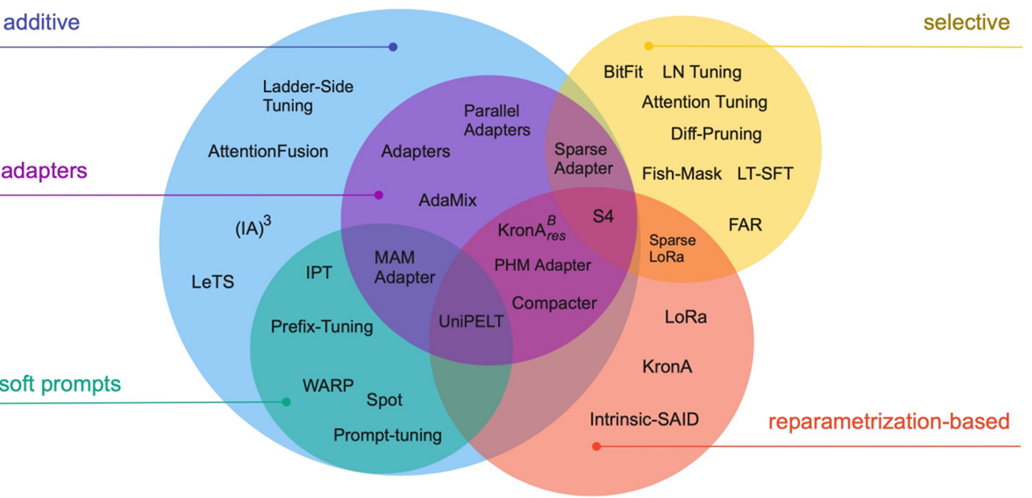
PEFT (BACKUP SLIDE)
•PEFT, Parameter Efficient Fine-Tuning is a set of techniques to fine-tune a large model in the most compute and time efficient way possible by either freezing whole model or some parts of it without compromising performance.

Slide 34
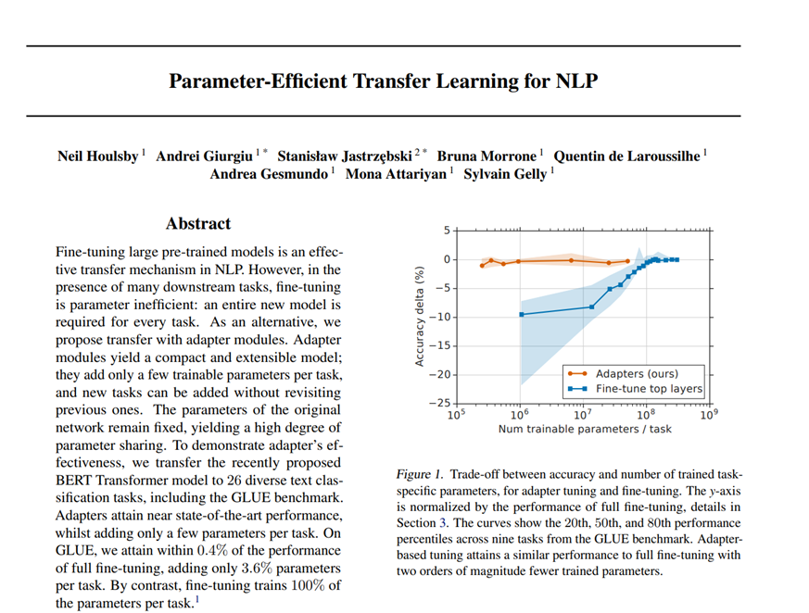
Adapters (BACKUP SLIDE)
Adapters were one of the first PEFT techniques released. They showed that, adding more layers to the pre-existing transformer architecture and only finetune them instead of the whole model performs similar to complete fine-tuning with less resources.

Slide 35
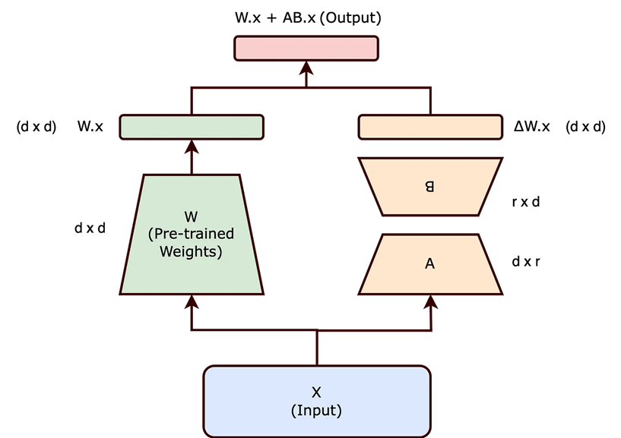
LoRA (BACKUP SLIDE)
•LoRA – Low-Rank Adaptation is like Adapters but aims to further reduce the trainable parameters. It works by modifying how the updatable parameters are trained and updated in neural network.
•Pretrained neural network weights are initially full rank, with each weight unique. Upon fine-tuning for specific tasks, these models exhibit a lower "intrinsic dimension," indicating weights can be represented with fewer dimensions.
•Authors in the paper proved that LoRA can outperform full finetuning with only 2% of total trainable parameters.
Updating Weights
Notes:
This suggests that during fine-tuning, updates to the weight matrix are of lower rank, as most necessary information is already learned during pre-training, and only task-specific adjustments are made.

Slide 36
QLoRA (BACKUP SLIDE)
•QLoRA improves over LoRA by quantizing the transformer model to 4-bit precision and using paged optimizers to handle memory spikes.
•Usually, parameters of trained model stores in 32-bit format, Using QLoRA we compress them to a 4-bit format. It reduces the memory footprint of the LLM, making it possible to finetune on a single GPU.

Slide 37
BERT: Bidirectional Encoder Representations from Transformers
(BACKUP SLIDE)
Used for
Sentiment Analysis, Question Answering
Text prediction, Text generation
BERT works by
Training large amount of data
Masked language model (MLM)
Next sentence prediction (NSP)
Built using transformers
Transformers
Attention mechanism
Helps BERT with parallel training of large datasets
BERT based models: PatentBERT, DocBERT, BioBERT, VideoBERT, ALBERT, RoBERTa etc.
Newly added slide
Notes:
Pay attention only to the things that matter without wasting computational resources.

Slide 38
Task 1: LLM Model and Comparison
RoBERTa/ChemBERTa (LLM)
XGBoost
Random Forest
1. Robustly optimized BERT training approach
2. Builds on BERT,
- Modifies hyperparameters, removing the next-sentence pretraining objective
- Training with larger batches and learning rates
3. Dynamic masking (training)
4. Byte pair encoding
Tree-based algorithm
Boosting technique
Aggregates output
Sequential learners
Good for smaller datasets
Tree-based algorithm
Bagging technique
Aggregates output
Independent learners
Good for smaller datasets
Notes:
Aggregate Output: Major Voting or Averaging
Contextual Learning: finding important tokens based on surrounding tokens

Slide 39
Goal 1: Molecular property prediction
Challenges:
Identifying potential tokenization technique.
LLMs require huge data where we had only 5000 samples and extended to 90000.
Selecting appropriate model and its hyperparameters is time intensive.
Resources:
We used Nvidia RTX4060 to train character level and atomic level models.
We used DARWIN V100 gpus to train hybrid model i.e., SPE tokenization, RoBERTa and XGBoost.

Slide 40
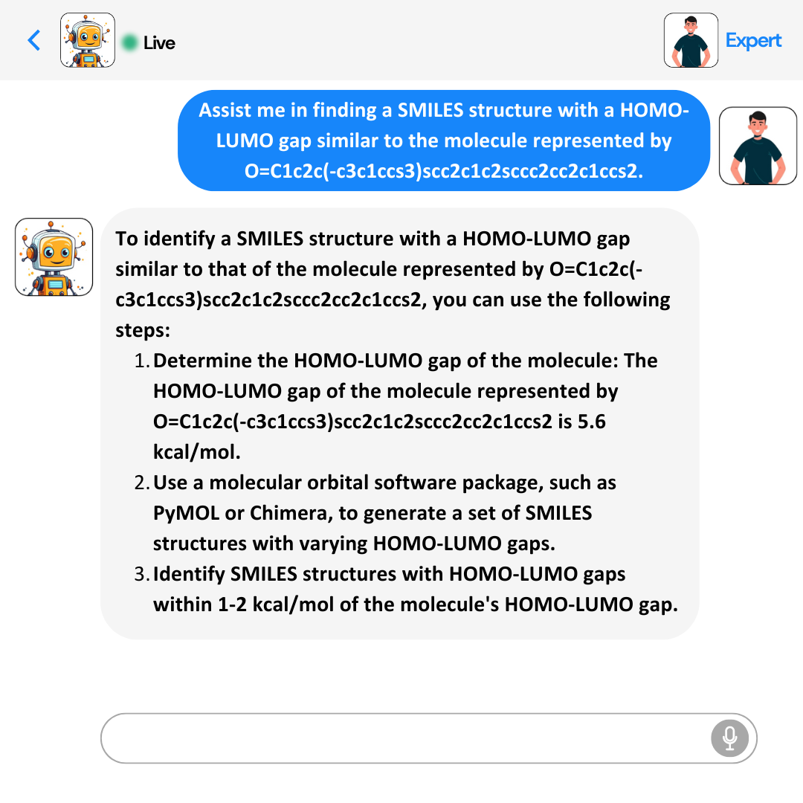
Demo of Llama-2-7B-Chat Model Performance
Before Fine Tuning
After Fine Tuning
Takeaway: Fine-tuning large language models for specific tasks can be achieved without the need to adjust every parameter in the model.

